Slide 1
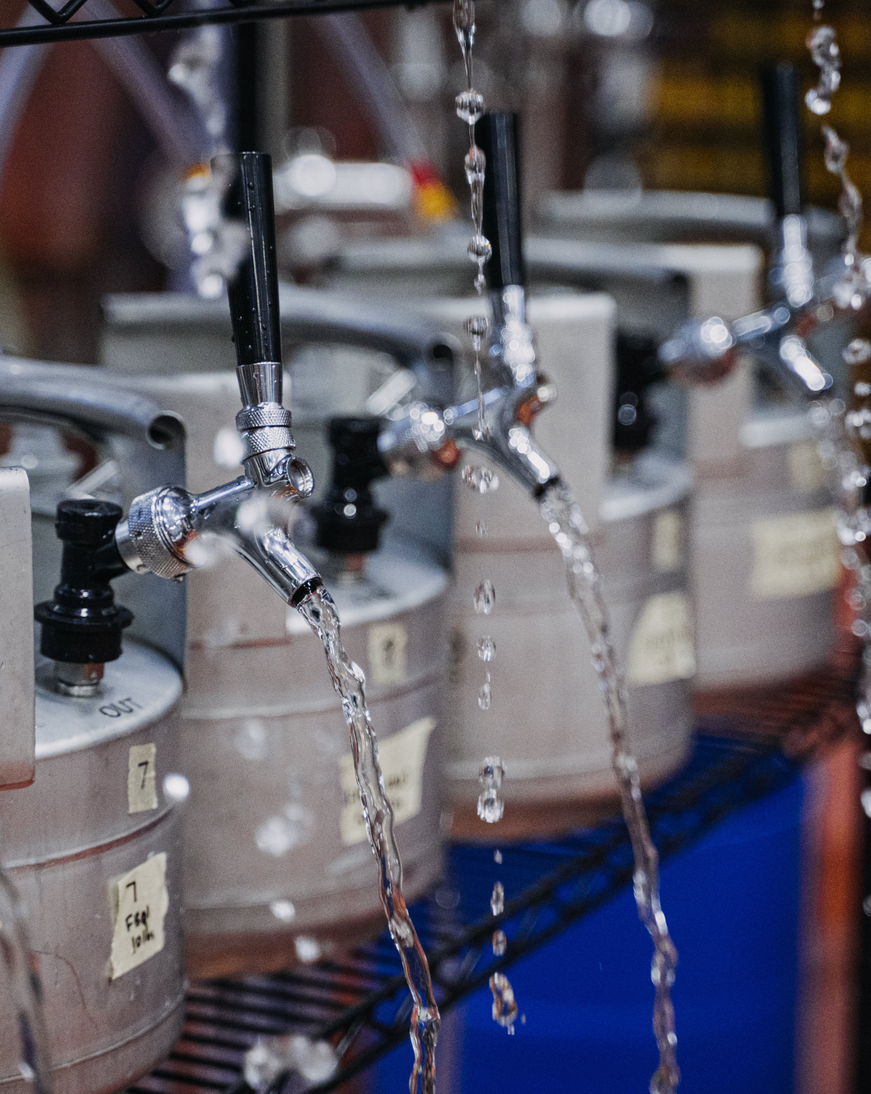
But Sometimes You Get What You Need: Using R to Optimize Dry Hop Mixtures for Aroma and Flavor
Trent Leslie, Becca Ransohoff, Chandler Cottrell, Doug Scott
MadTree Brewing Company

Slide 2
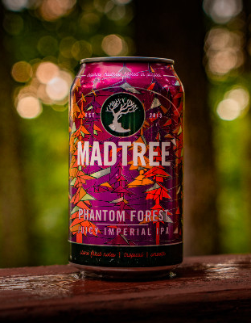
The Plan
Background & Resources
Introduction to the Experiment
Experimental Design, Hardware, & Data Collection
Data Format
The Script
What It Does and What It Does NOT Do
The Output
Ternary Contour Plots & Correlation Plot
Putting It All Together
Q&A

Slide 3
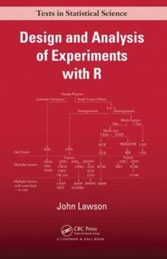
Background & Resources
2016 WBC Talk: Improving Brewhouse Efficiency by Adjusting Mash Thickness and Lauter and Sparge Volumes (Eddie Gutierrez and Drew Russey)
2017 ASBC Talk: Simplify QAQC Analyses and Decision Making with Open Source Software (Drew Russey)
2017 MBAA TQ: Improving Brewhouse Efficiency by Adjusting Mash Thickness and Lauter and Sparge Volumes (Eddie Gutierrez and Drew Russey)
2019 ASBC Workshop: From Bytes to BeeR: Leveraging the Statistical Programming Language R in Brewing Data Science (Drew Russey, Lucas Chadwick, Trent Leslie)
http://bit.ly/ASBCCodingWorkshop2019 (Video tutorials!)
2021 ASBC Talk: You Can’t Always Get What You Want - Use of Design of Experiments (DOE) to Optimize Dry Hop Mixtures for Aroma and Flavor (Becca Ransohoff, Chandler Cottrell, Trent Leslie, Doug Scott)

Slide 4
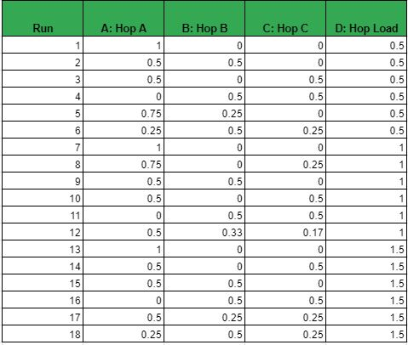
Introduction to the Experiment
Goal – Finalize a dry-hop recipe for a new Double IPA recipe
Mixture experiment
Experimental Variables – 3 different hops
Hop A – 0-100%
Hop B and C – 0-50%
Experimental Ranges – Range of 0-1.5x dry hop rate (1.9 lbs/bbl)
Things we did not study – any hot side changes, limited to 3 hops, yeast strains

Slide 5
Introduction to the Experiment
Eighteen runs collected into torpedo kegs
Collected Post-fermentation, pre-dry hop beer from the fermenter and dry hopped in the torpedo kegs
Sensory Panel
Each panelist was given 10 samples (incomplete block design)
Data is blocked by panelist to remove variation contributed from the panelists (everyone uses the scales differently)

Slide 6
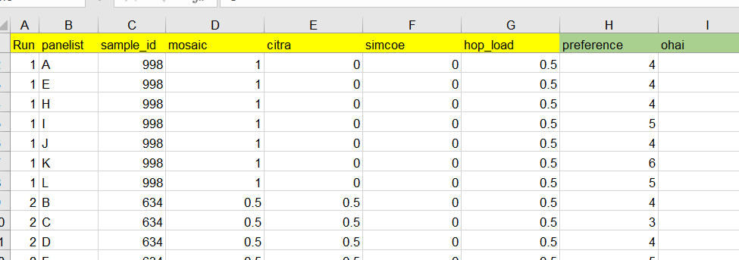
Input Data Format
Excel Spreadsheet (but that can be changed in the script)
First seven columns need to be there
However, the hop name columns can be changed to reflect whatever the experiment entails, but the script will need to be updated for that as well
Columns eight and on can be as many or as few as you want and can be anything

Slide 7
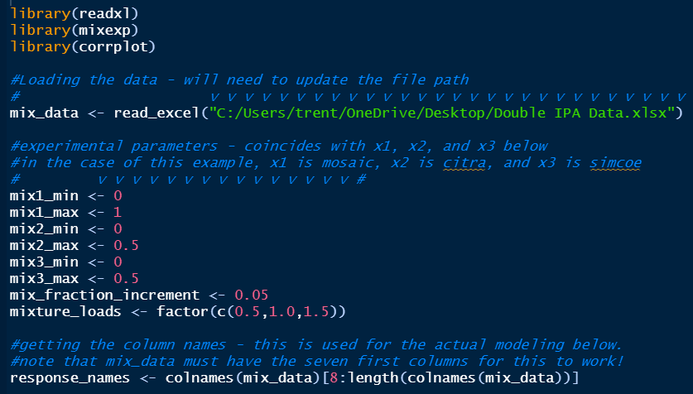
The Script
Script and Powerpoint files are available on GitHub
https://github.com/trentleslie/ASBC_2021

Slide 8
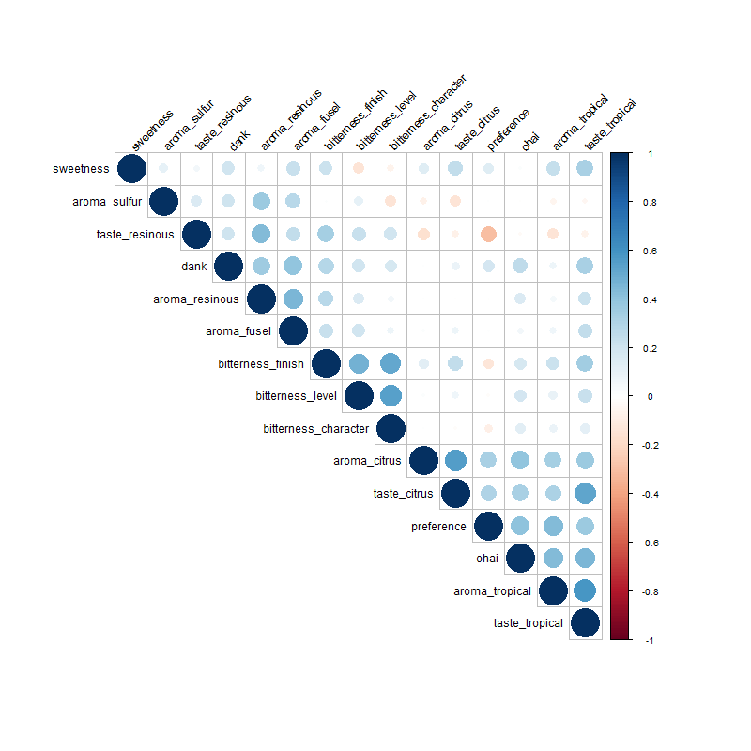
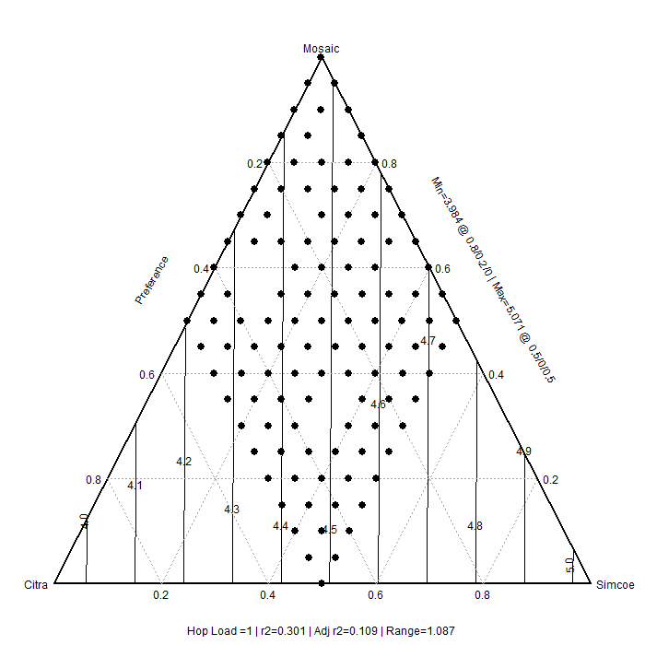
The Output

Slide 9

Putting It All Together
This brings us to the hard part: using your own judgement and conversations to determine what’s important and what’s most likely to lead to the best possible product.
Sensory is often messy, but design of experiments and this script may help provide guidance.

Slide 10
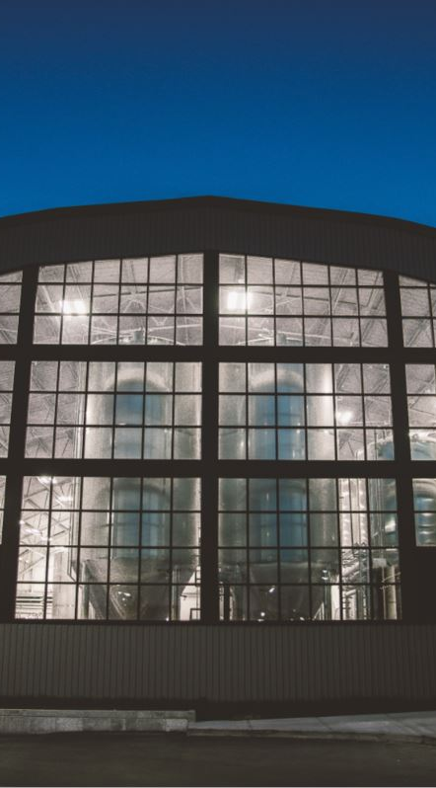


Flavor Space Force Research Group
Becca Ransohoff
Doug Scott
Chandler Cottrell
Ryan Blevins
Garrett Schnieber

Slide 11
Notes:
SAY:
It’s time to answer some of the questions you’ve been asking from the Q&A panel.
DO:
Make sure to use their name and show appreciation for the comment.

